Slide 1
Amazon Sales Analysis

Slide 2
Introduction
Amazon is an American Tech Multi-National Company whose business interests include E-commerce, where they buy and store the inventory, and take care of everything from shipping and pricing to customer service and returns.
Tools Used
Power BI — Data Cleaning, Transformation, Analysis, and Creating Reports.

Slide 3
Main KPIs
Total Sales = 450k
Total Profits = 53k
Quantity = 6251
Average Delivery = 4
Top Categories by Sales
Top Sub-Categories by Sales
Top Sales by Ship mode
Sales and Sum of Profit by State
Sales by Segment
Sales by Payment mode
Sales by Month and Year
Profit by Month and Year
Sales by State
Sales forecast-15days

Slide 4
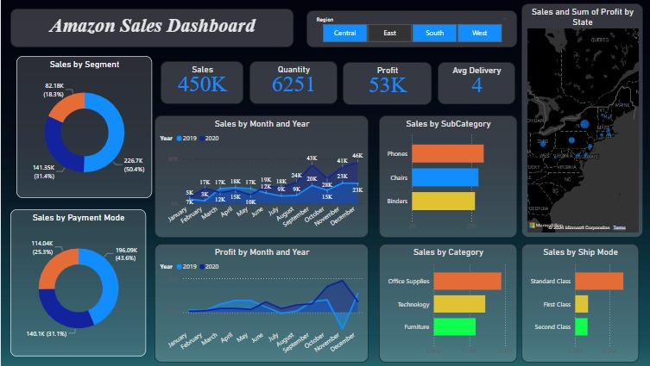
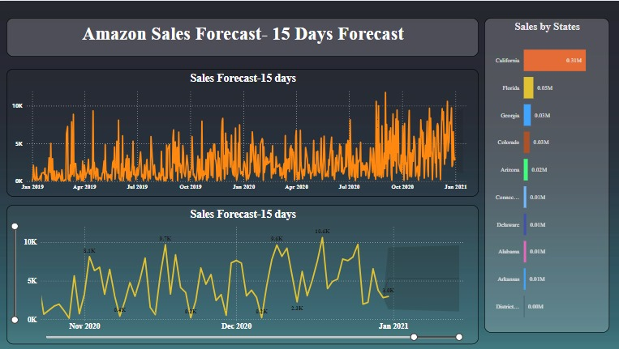
The Dashboard

Slide 5
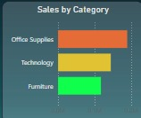
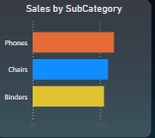
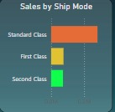
Visualization:
Generated the following visual analyses using Power BI.
Sales of Category , Sub-Category , Ship-mode

Slide 6
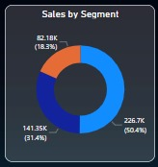
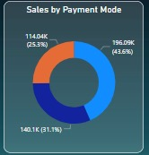
Sales by Segment , Payment mode

Slide 7
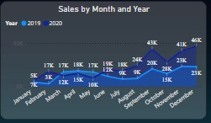
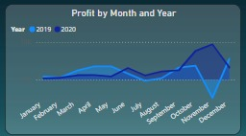
Sales by Month and Year , Profit by Month and Year

Slide 8
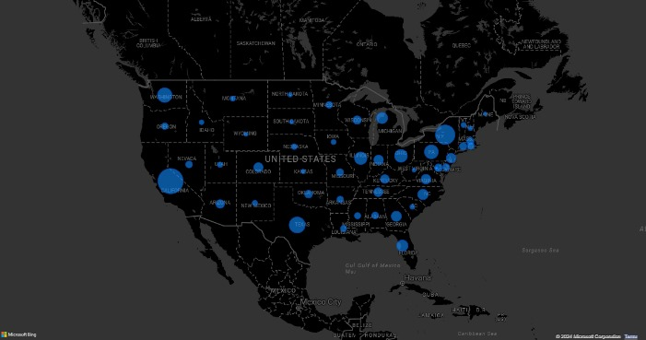
Sales and Sum of Profit by state

Slide 9
Reference
For product sales from E-commerce stores and related, you may refer to kaggle.com

Slide 10
Thank You

